Slide 1
Welcome to “Consumerism & Sustainability”
Thursdays from 6:10-8:00 PM
Online only
Prof. Celine Ruben-Salama
  Office Hours
  -Before or after class, or by appointment
TAs: Claudia Canal and Via Callistha
  Office Hours by appointment

Slide 2
Today’s Agenda
Ground rules
Introductions
Course context
Course overview
Consumerism, where it all began
Next week

Slide 3
Ground Rules
Come to class, participate, be engaged – don’t be shy!
Try to do the readings – ok to split the reading among friends
OK to use computers/phone in class to take notes, reference reading materials, look up facts, figures and info
NOT OK to use computers/phone in class to write emails, work on anything unrelated to this class

Slide 4
Introductions

Slide 5
Celine Solsken Ruben-Salama
Swedish/American “born” environmentalist… in Kenya
MBA Marketing, BBA Entrepreneurship, MPA Environmental Science Policy
FOR THE LONG-TERM – Corporate Sustainability Consultancy
Deep expertise in corporate sustainability with a focus on climate change
Career
IT > Finance > IT for Finance
Social Entrepreneurship > Strategic Marketing > Communications
State/Local Gov’t, UN
Sustainability for Finance > Sustainability for Corporates
Notes:
IT/Finance: Strategic IT Implementation, Efficiency, Virtual Office
Razorfish, Deutsche Bank, Citibank
Strategic Marketing
Discovery Channel/Planet Green
Social Entrepreneurship
Cozy iPod accessories (Fair Trade/Organic)
Communications
un.org/climate change, treehugger.com, Yahoo Green, Inhabitat, EcoGeek

Slide 6
My Point of View
Grew up semi-off the grid, geothermal heating, compost
“Enviro” Capitalist
  Economy, environment and people are interdependent
  Broadest possible view of sustainability
Integrating sustainability into our current system → HUGE OPPORTUNITIES

Slide 7
About the TAs

Slide 8
TAs, Claudia Canal & Via Callistha
Responsibilities
  Track class participation
  Provide feedback on weekly writing assignments
  Assist with term projects
Office hours: by appointment
  Claudia: cc4599@columbia.edu
  Via: oc2287@columbia.edu

Slide 9
TA, Osritrivia Callistha
SUMA ’21
Work experience: 2+ years of working experience in the marketing Industry (traditional marketing and digital marketing). Worked with: Unilever Indonesia and Coca-Cola Indonesia
Home town: Jakarta, Indonesia
Lived in: Birmingham, UK; Jakarta, Indonesia; Singapore; NYC, US
Fun fact: I spent the summer of 2020 interning with a sustainability consulting company in Bali. Part of the research was on elephant manure and its potential as a biogas input to avoid the waste being dumped into the river.
Interested in: Waste Management, Circular Economy, and Corporate Sustainability

Slide 10
TA, Claudia Canal
SUMA ’21
Work experience: 3+ years working as a sustainability consultant covering an array of projects ranging from corporate reporting and data assurance to deploying waste management programs.
Home town: Barcelona, Spain
Lived in: Barcelona, Charlottesville, New York
Fun fact: during quarantine, I spent many Monday afternoons feeding and cleaning horses, donkeys and cats as a volunteer at an equine rescue center in Virginia.
Interested in: disruptive Corporate Sustainability projects, Sustainable Product Development, Waste Management and Sustainable Agriculture.

Slide 11

Getting to Know You
http://etc.ch/bWCG
Notes:
Results link: https://directpoll.com/r?XDbzPBd3ixYqg8SO9chxXFg0oCGgWl9oEnTt4iBkI

Slide 12
Course Context

Slide 13
Course Context
Consumerism is an important engine of the world economy
Market failures exist and create opportunities
Companies have an important role to play
How to get sustainable marketing right
Lucrative opportunities exist from decoupling negative environmental impact from economic activity
Corporate point-of-view

Slide 14
1. Consumerism is an important engine of the world economy

Slide 15
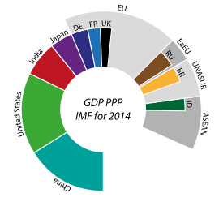
World Economy
Population ~7 billon
GDP $77 trillion
GDP growth 3.4% per year
(pre COVID)

Slide 16
Gross Domestic Product (GDP)
Broad measurement of economic activity/economic health
GDP is the monetary value of all the finished goods and services produced within a country's borders in a specific time period (annually)
GDP = C + G + I + NX; Where:
  C is the sum of all domestic consumer spending
  G is the sum of government spending
  I is the sum of all investments and capital expenditures
  NX is total net exports (exports-imports)
Read more: Gross Domestic Product (GDP) Definition | Investopedia

Slide 17
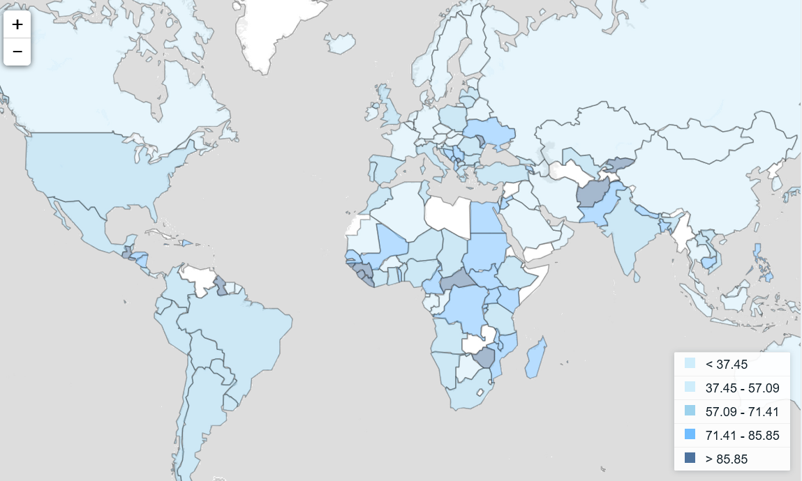
Household final consumption expenditure (% of GDP), 2014
Source: http://data.worldbank.org/indicator/NE.CON.PETC.ZS?view=map

Slide 18
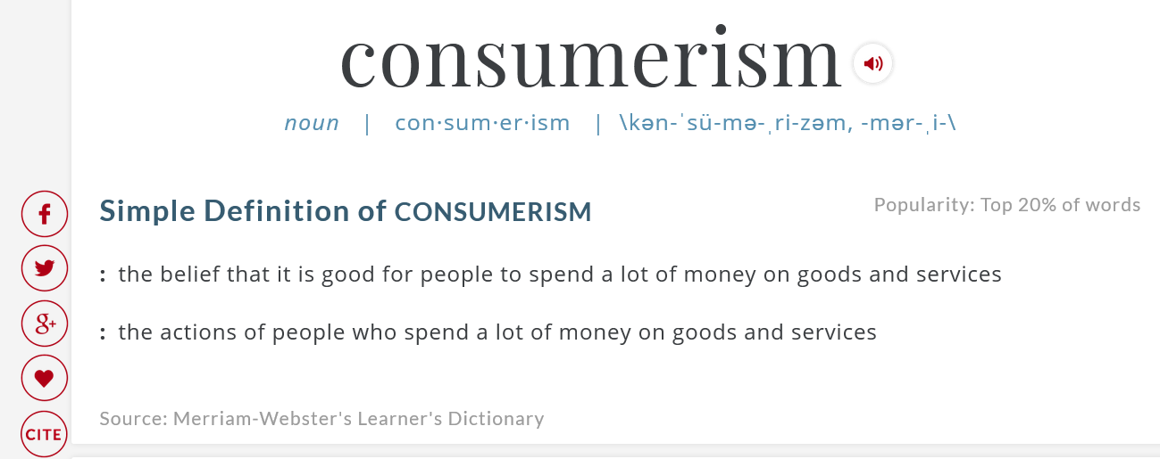

Slide 19
Responsible Consumption?
Consumerisms is a “complex, interdependent system with financial and governmental as well as commercial components”
“Nearly everybody wants an economy with more jobs and higher returns on investments, so for a majority the incentive to shut up and get with the program is overwhelming.”
We are all complicit.
(The Brief, Tragic Reign of Consumerism—and the birth of a happy alternative)

Slide 20
2. Market failures exist and create opportunities

Slide 21
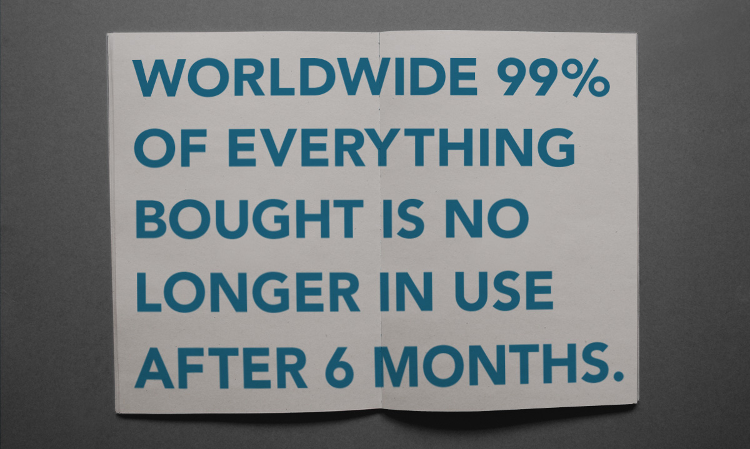
Notes:
"Natural Capitalism" by Paul Hawken, (1999) p. 81.

Slide 22
Market Failure Creates Opportunity
Society absorbs negative externalities → Polluter pays
All economic activity is good? → Positive and negative impacts should be evaluated
Design for the dump → Zero waste
Linear systems → Circular systems
Depletive systems → Renewable systems

Slide 23
3. Corporations have an important role to play

Slide 24
Corporate Point of View
What aspects of consumerism do companies control?
  Production >>Supply
What is the purpose of a corporation?
  Characteristics of a corporation?
  Sustainability challenges?
    Corporates?
    Start-ups?

Slide 25
Time for Responsible Capitalism...
The aim of capitalism is to maximize corporate profits
  Short-term view
  Systems focus on single bottom line
  Does not take environmental and social capital into account!
“Unintended” consequences
  Resources constraints
  Climate change
  Pollution
  Unsafe products

Slide 26
Stages of Corporate Sustainability
COMPLIANT
VESTED
INNOVATOR
TRANSFORMATIONAL
Little Stakeholder Engagement
Rejection
Strategic
pro-activity
Sustainable value creation
Compliance
Efficiency
Shared Values
Defense: Risk Avoidance
Offense: Profit and Purpose
Adopted from Bob Willard’s, “The Next Sustainability Wave”
26

Slide 27
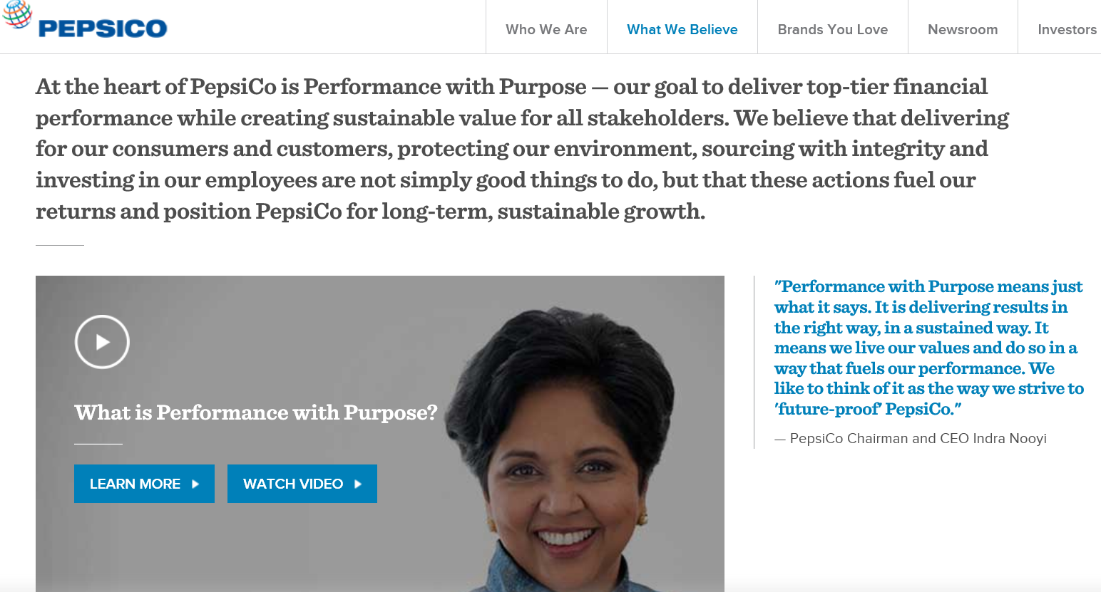

Slide 28
Role of Corporate Sustainability Professionals
Focused on big picture outcomes
  Reduce negative impacts
  Improve positive impacts
  Incremental change vs. Innovation
  Change consumer attitudes and habits
    Normative (judgement-based) vs. Positive (fact-based)
28

Slide 29
4. How to get (sustainable) marketing right

Slide 30
Product/Service
Sustainability Interventions
  Product-related impacts
    Reduce negative
    Improve positive
  Operations-related impacts
    Reduce negative
Existing product
  Incremental improvements
  Revamp
New product
  Innovation
30

Slide 31
Beware of Bias!
Change product > Improve sustainability outcomes!
Sustainability professionals have a bias for product-orientated thinking!!!
31

Slide 32
Education and Behavior Change?
Motivate behavior change through education?
  Assumes that people act rationally
  Environmental issues can be emotional!
Assumes changing attitudes changes behavior
  We need behavior change
  Outcomes are important, not motivations
Use the full strategic marketing framework to maintain consumer-centric / market-orientation!

Slide 33
Strategic Marketing Framework
Segmentation
MARKETPLACE
OUTCOMES
Consumers needs satisfied
Companies generate sales
Society
GDP growth & externalities
Targeting
Consumer Behavior
Market Analysis
UVP
Positioning
Marketing Mix
-Product
33

Slide 34
Course Overview
Notes:
My background
Charlotte’s background
Office hours posted on CourseWorks

Slide 35
CONSUMERISM & SUSTAINABILITY
Upon completion of this class, you will be able to apply the strategic marketing framework and LCA analysis to successfully launch commercially viable, sustainable products and services into the marketplace.

Slide 36
Success through Alignment
Apply strategic marketing framework
  Develop a customer-centric point-of-view
  Understand consumer needs
  Capitalize on competitive advantage
  Be sensitive to business goals
  Avoid bias
Lifecycle Assessment (LCA)
  Understand products & services quantitatively and qualitatively
  Target hot-spots effectively
  Reduce negative impacts
  Improve positive impacts
36

Slide 37
Learning Goals
• Assess a company’s internal strengths and weaknesses, sustainability strategy and performance and its position in the marketplace vis-à-vis competitors
• Segment consumers based on needs, behavior and attitudes
• Use cognitive behavioral model to predict consumer behavior in the marketplace
• Identify profitable business opportunities related to achieving sustainability goals

Slide 38
Learning Goals
• Use Life-cycle Analysis (LCA) to identify and define the environmental impacts of any given product and distinguish sustainable products from conventional products
• Define and assess alternative strategies to improve product sustainability while maintaining commercial viability using strategic marketing framework to perform product-level market analysis including: sizing, competitive analysis, segmentation, and targeting
• Craft effective communications and marketing strategies for sustainable products, services, and companies
• Effectively engage consumers, suppliers and other stakeholders in behaviors that enhance sustainability and promote brand value and loyalty

Slide 39
Weekly Themes

Slide 40
Weeks 1-3
Understanding the Marketplace and the Players
Conduct Industry analysis
Assess a company’s internal strengths and weaknesses (SWOT/ROWS)
Assess a company’s sustainability strategy/performance
Determine a company’s position in the marketplace vis-à-vis competitors
>>>Identify profitable business opportunities related to achieving sustainability goals

Slide 41
Weeks 4-5
Understanding Consumers
Use cognitive psychological model to predict consumer behavior in the marketplace
Apply “Jobs to be Done Theory” to understand consumer needs
Segment consumers based on needs, behavior, and attitudes (product-related and sustainability)
Craft key messages that resonate with target audience

Slide 42
Weeks 6-7
Understanding Products
Understand product UVPs (USP)
Use strategic marketing framework to perform product-level market analysis
Use Lifecycle Analysis (LCA) to identify and define the environmental impacts of any given product and distinguish sustainable products from conventional products
Define and assess alternative strategies to improve product sustainability while maintaining commercial viability

Slide 43
Weeks 8-11
Understanding Communications and Strategy
Effectively engage consumers, suppliers and other stakeholders in behaviors that enhance sustainability and promote brand value and loyalty.
Presentations, Case Study, and Opportunities Workshop
Weeks 12-14
Tying it all together

Slide 44
Readings
Books
“Cradle to Cradle”
Mainstream Green (available in PDF online)
Optional: “Competing Against Luck”
Articles & Reports – on Canvas

Slide 45
Evaluation
Participation (Individual) – 10%
10 Writing Assignments (Individual) – 45% (4.5% each)
Term Project Presentation (Group) – 15% (Peer graded)
Term Project Report (Group) – 30%

Slide 46
Writing Assignments
10 Writing Assignments (Individual) – 45%
Rubric
  Point of view (45%)
  Did you answer the question and take a strong stance
  b) Supporting evidence (45%)
  Did you use examples from your experience, readings, current events to prove your point
  c) Writing style and grammar (10%)
  Is it easy for the reader to grasp your main point and is the writing error free

Slide 47
Writing Assignment Topics
Impacts of your lifestyle
Are consumers rational?
Industry analysis
Is sustainability mainstream?
Analysis of Sustainability Ads
Case Studies: Nike, The Body Shop, Population Services International
Identifying new (sustainable) business opportunities

Slide 48
Term Project
In groups of four or five, you will create a proposal for the redesign of a flagship product produced by a Global 1000 company. The proposal will include a go-to-market plan.
The redesign should:
  Improve on existing product’s ecological footprint;
  While maintaining mainstream appeal and commercial viability.
Deliverables
  15-20 page report – 30% of grade
  15 minute presentation with slides - 15% of grade

Slide 49
Term Project: Report
1. Internal/External Analysis
SWOT/ROWS Analysis
Market Analysis (company and product-level)
Corporate sustainability profile/sustainability context
  E-STEP and ESG analysis
2. Product: Redesign Concept
Life-cycle Analysis (LCA) Analysis
Ecological impact of redesign
Assessment of redesigned product’s commercial viability

Slide 50
Term Project: Report (cont.)
3. Go-to-Market Plan
Articulation of target segments
Marketing strategy – 4Ps
  Product
  Price
  Placement/Distribution strategy
  Promotions

Slide 51
Weekly Cadence
Tuesdays before midnight: Writing assignment
Thursdays
  Reading should be completed
  Office hours: before/after class
  Class: Thursdays 6:10-8pm
  Feedback on writing assignments
Fridays/Weekends after class: Term project milestone – “due”

Slide 52
Canvas

Slide 53
Questions?

Slide 54

CONSUMERISM, WERE IT ALL BEGAN

Slide 55
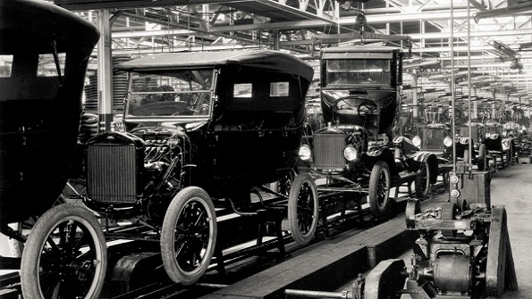
Industrial Revolution
Industrial Revolution
(18th-19th century)
Innovations increase efficiency
Refined Coal, Steel, Combustion Engine
Mechanization increases supply of goods at lower prices
Economies of Scale

Slide 56
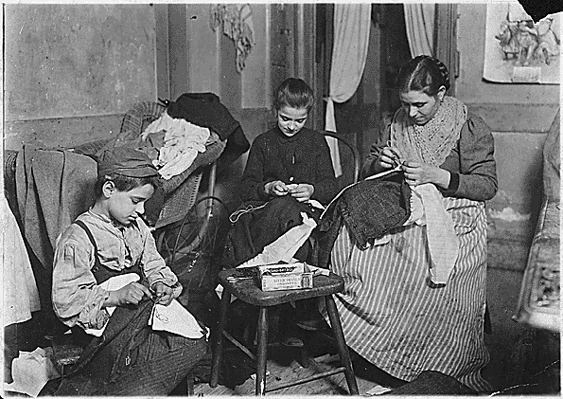

Slide 57
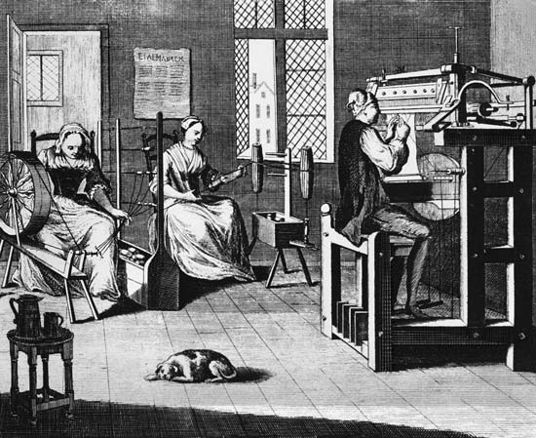

Slide 58
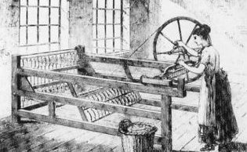

Slide 59
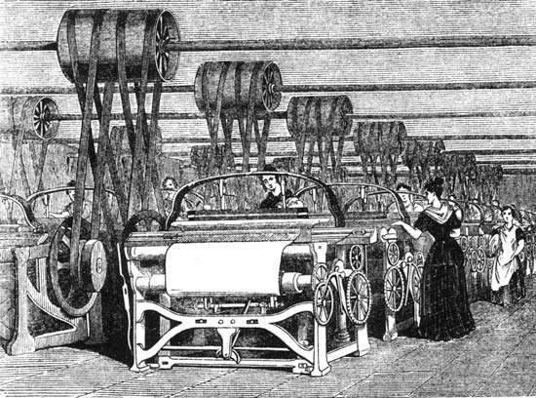

Slide 60
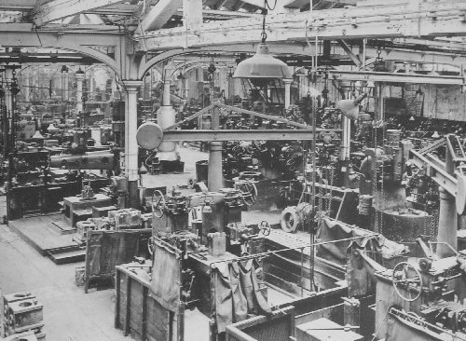

Slide 61
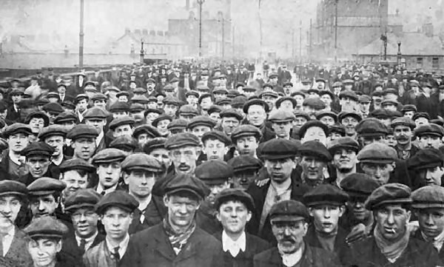

Slide 62
Birth of Consumerism
Demand for factory workers drives urban migration
Lack of Regulation keeps costs down and prices low
    Negative externalities: Pollution, Workers Rights, Sanitation, Living Standards

Slide 63
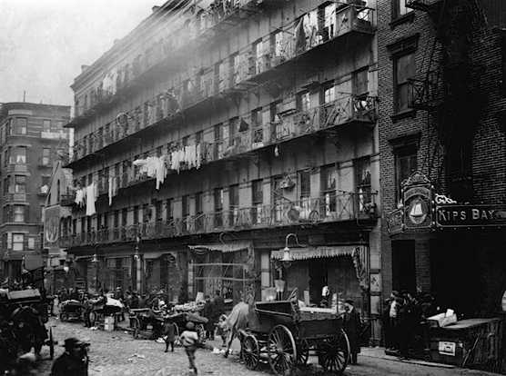

Slide 64
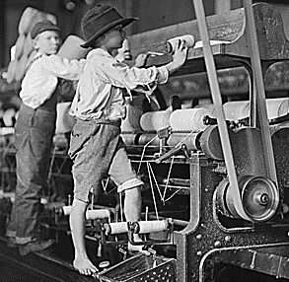

Slide 65
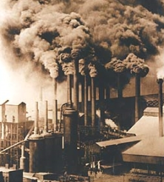

Slide 66
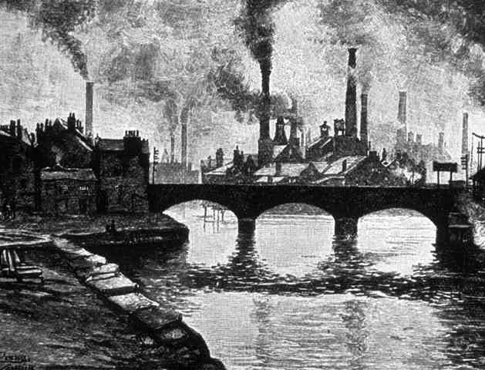

Slide 67
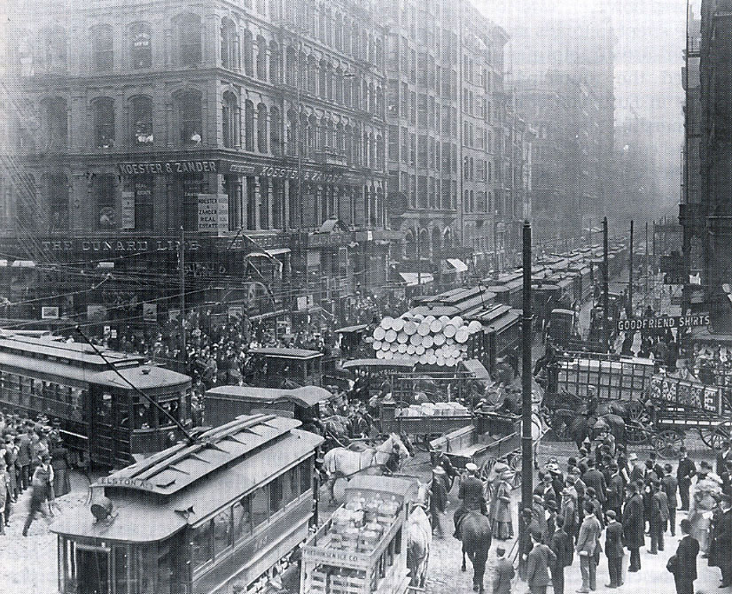

Slide 68
Theory of the Leisure Classes (1899)
By Torstein Veblen
The Leisure Classes?
Spending on goods and services to display wealth
  Conspicuous Consumption
  Conspicuous Waste

Slide 69
Theory of the Leisure Classes (1899)
Mass production as a way to universalize the trappings of leisure
Per capita income increases 10-fold
  Disposable income → Consumption
The owning class could engage workers in an endless pursuit of status symbols deflecting their attention from society’s increasingly unequal distribution of wealth and from their own political impotence

Slide 70
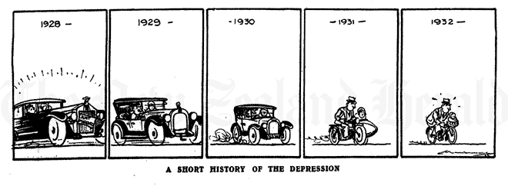
Great Depression (1929-1939)
New Deal → Reaction to the New Deal…
US National Association of Manufacturers enlisted a team of advertisers, marketers, and psychologists to formulate a strategy to counter government efforts to plan and manage the economy in the wake of the Depression

Slide 71

The American Way
Massive, ongoing ad campaign to equate consumerism with “The American Way”
Progress would henceforth be framed entirely in economic terms, as the fruit of manufacturers’ ingenuity
Americans were to be referred to in public discourse (newspapers, magazines, radio) as consumers, and were to be reminded at every opportunity of their duty to contribute to the economy by purchasing factory-made products, as directed by increasingly sophisticated and ubiquitous advertising cues.

Slide 72


Slide 73

World War 2 (1939-1945)
US manufacturing capacity focused on supporting war effort
  Women in the workforce
Following the war, global manufacturing capacity decimated…
…US had surplus capacity!

Slide 74
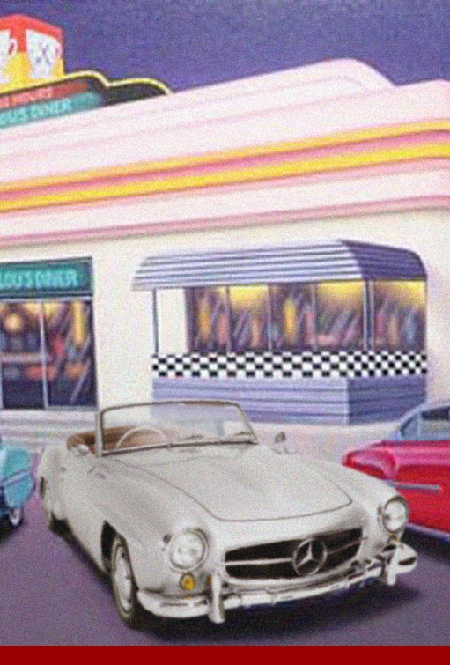
Post-War USA
Expansion of the middle class → “The Good Life”
Suburbs
  Car culture
Consumer credit
  Buy now, pay later
Marketing/Advertising
Television
Consumerism takes hold!

Slide 75
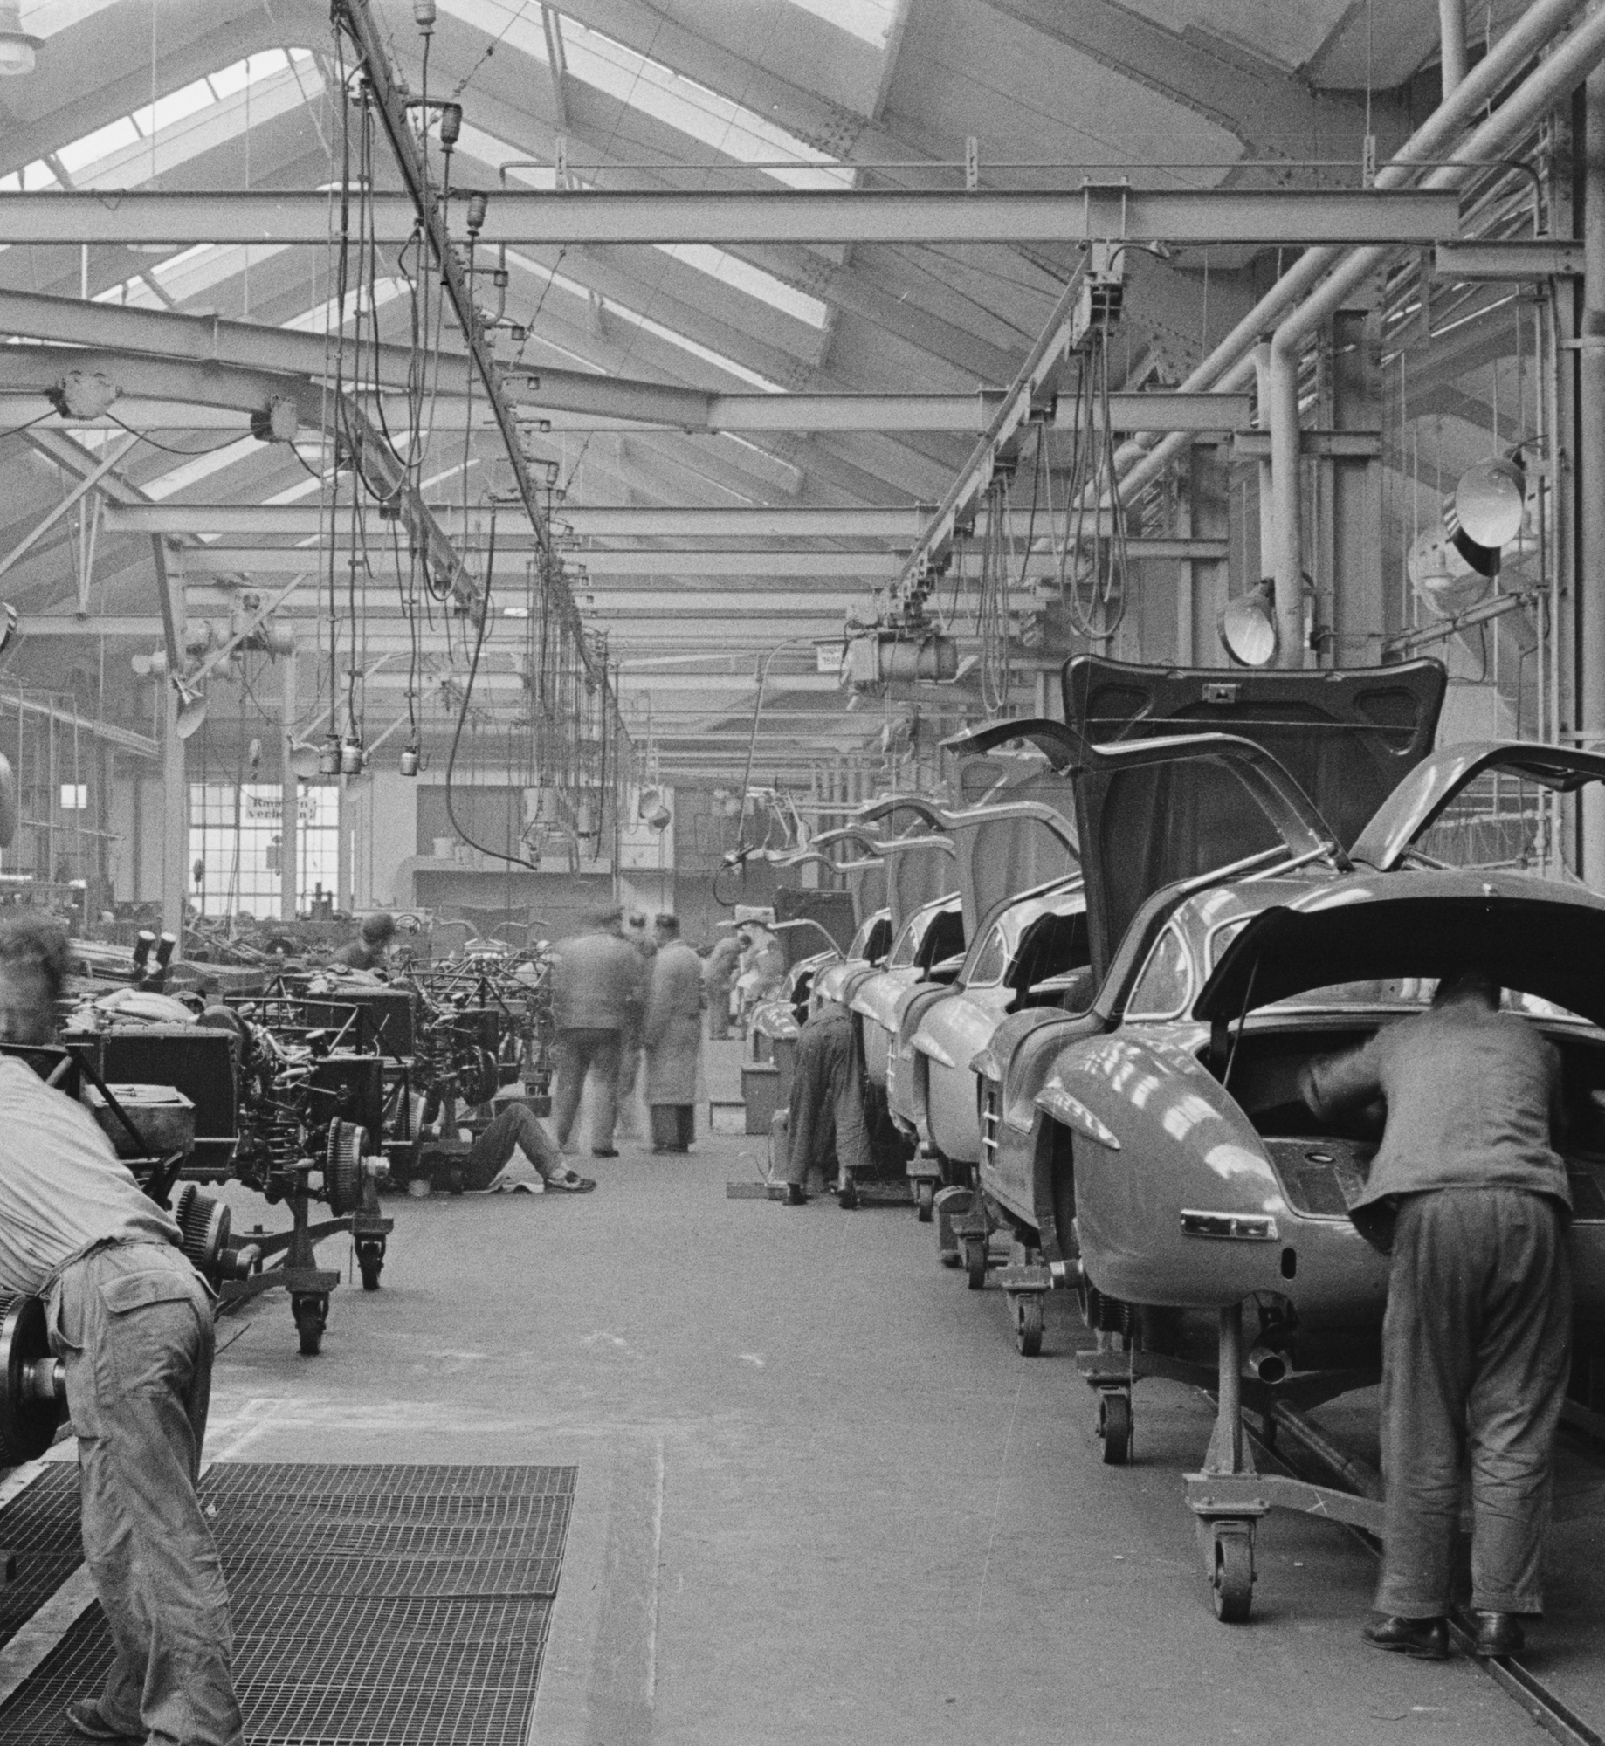
Overproduction
Excess manufacturing capacity
→ Commodity boom
More is better
Lebow: “These commodities and services must be offered to the consumer with a special urgency”

Slide 76

Spiritual Satisfaction
“Our enormously productive economy demands that we make consumption our way of life, that we convert the buying and use of goods into rituals, that we seek our spiritual satisfactions, our ego satisfactions, in consumption”
“The very meaning and significance of our lives today expressed in consumptive terms”
-Lebow

Slide 77

Conspicuous Consumption
“The measure of social status, of social acceptance, of prestige, is now to be found in our consumptive patterns”
“…[G]oals are to look better, live better, dress better, travel better”
-Lebow

Slide 78
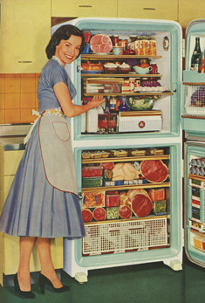
Conspicuous Consumption
“The chief characteristic of the consumer’s attitude toward his standard of living is that he wants to improve it. “
“The drive to emulate the upper social strata still plays an important role in providing goals for the consumer’s living standards”
-Lebow

Slide 79

Soap Operas (1948)
TV campaign to re-domesticate women
Shows sponsored by brands
Featuring home appliances

Slide 80
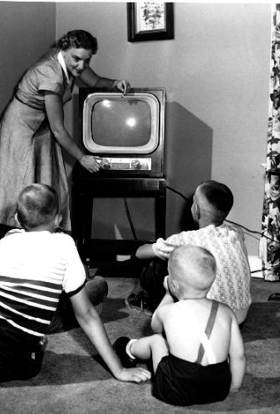
Role of Television
“Television actually sells the generalized idea of consumption.”
“And television achieves three results to an extent no other advertising medium has ever approached. First, it creates a captive audience. Second, it submits that audience to the most intensive indoctrination. Third, it operates on the entire family.”
-Lebow

Slide 81
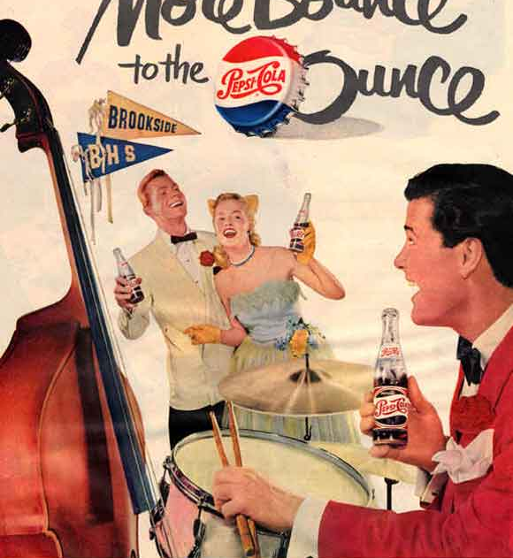
Social Pressure
“The standard of living to which the consumer aspires is shaped by the pressures upon him by manufacturers and retailers”
“The greater the pressures upon the individual to conform to safe and accepted social standards, the more does he tend to express his aspirations and his individuality in terms of what he wears, drives, eats- his home, his car, his pattern of food serving, his hobbies”
-Lebow

Slide 82
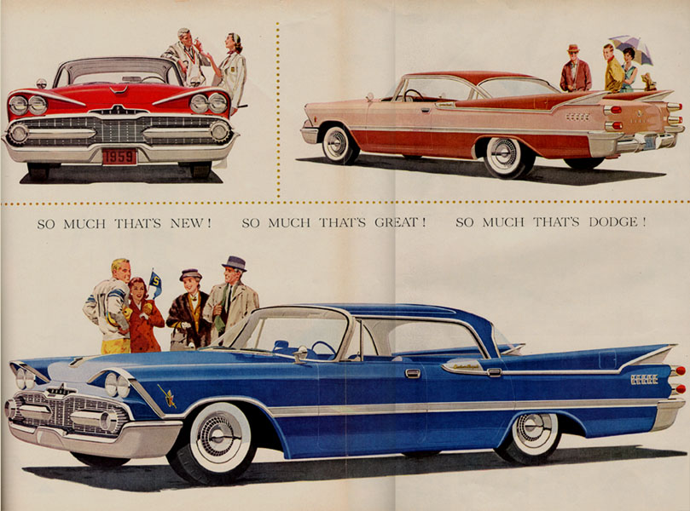
Planned/Perceived Obsolescence
“We need things consumed, burned up, worn out, replaced, and discarded at an ever increasing pace. We need to have people eat, drink, dress, ride, live, with ever more complicated and, therefore, constantly more expensive consumption”
-Lebow

Slide 83


Slide 84
Criticisms of Consumerism
Consumerism warps human values
  “Duane Elgin, Juliet Schor, and Vicki Robin have argued that relationships with a product or brand name are dysfunctional substitutes for healthy human relationships and that consumer choice is a soporific stand-in for genuine democracy.”
(The Brief, Tragic Reign of Consumerism—and the birth of a happy alternative)

Slide 85


Slide 86
...and the Happy Alternative
New structures and new strategies needed
  Tripple bottom line thinking
  Circular economy
  Terminate use of fossil fuels
  Innovation!
Align long-term societal value and corporate profits
  Happiness Index
  Optimize vs Maximize
Commit to Sustainable Development
  Authentic commitment to stakeholder engagement, transparency, and accountability

Slide 87

Next Week

Slide 88
Topics
Marketing Strategy
Strategic Marketing Framework
Unique Value Proposition
Sustainable Marketing
Discussion about Personal Consumption Footprints

Slide 89
Writing Assignment Sunday, 1/27
250-word posting about the global impacts of your lifestyle based on your ecological, carbon, water and slavery footprint (use calculators provided).
What are the impacts of your lifestyle? Any surprises? How do you compare to others?
Include suggestions for reducing your personal impact. Are they practical? How much control do you have over your impact?
Discuss pros and cons of the calculators and whether or not they are useful to consumers.

Slide 90
Other Assignments
Submit personal bio
Buy Cradle to Cradle
Term Project Milestone
Start forming term project teams
Group formation sheet - https://tinyurl.com/yy4g5u48

Slide 91
Required Reading
* Cradle to Cradle. Intro and Chapter 1, p. 3-44 (41 pages)
* Marketing in the 21st Century. (2006) (5 pages)
* The Consumer Adoption of Sustainability-Oriented Offerings: Toward a Middle-Range Theory. (2013) (13 pages)

Slide 92
Recommended Reading
* The Brief, Tragic Reign of Consumerism—and the Birth of a Happy Alternative. Post Carbon Institute. (2015). (6 pages)
* Price Competition in 1955. Journal of Retailing (1955). (7 pages)

Slide 93
See you next week!

